Slide 1


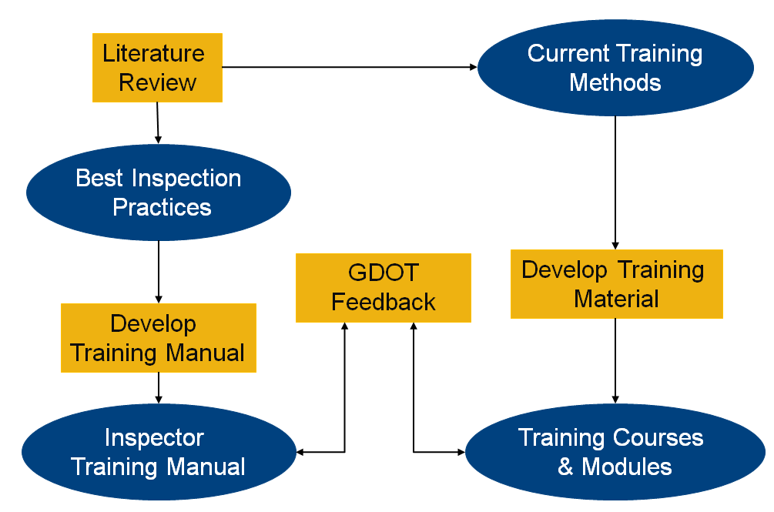
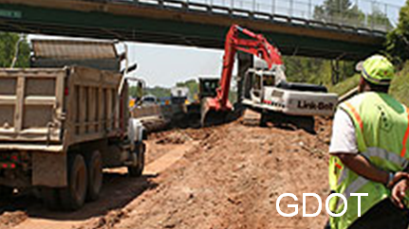
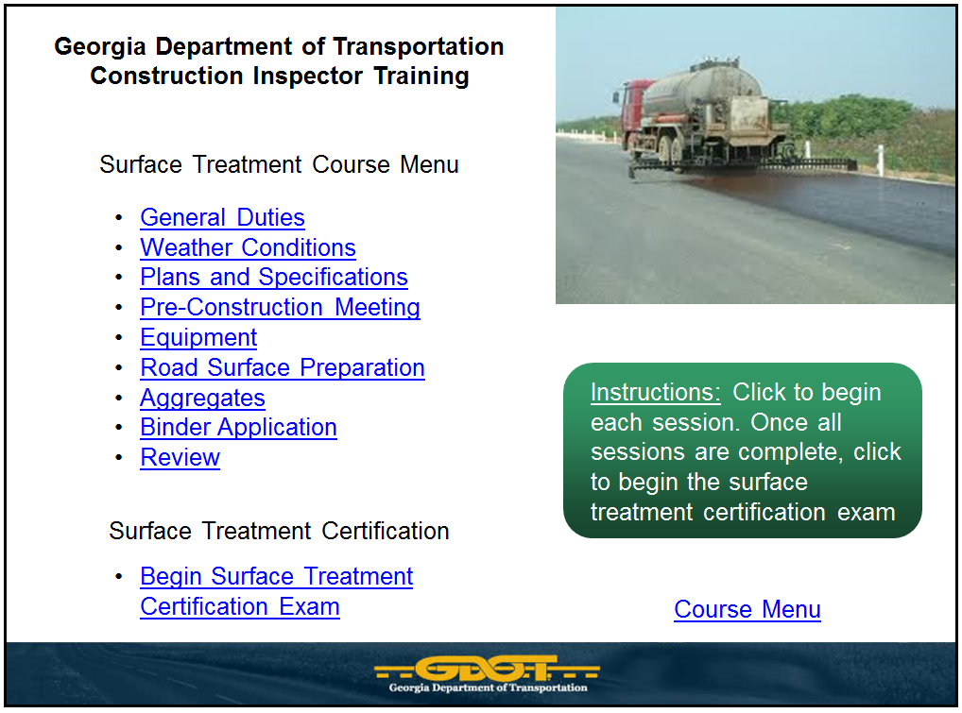
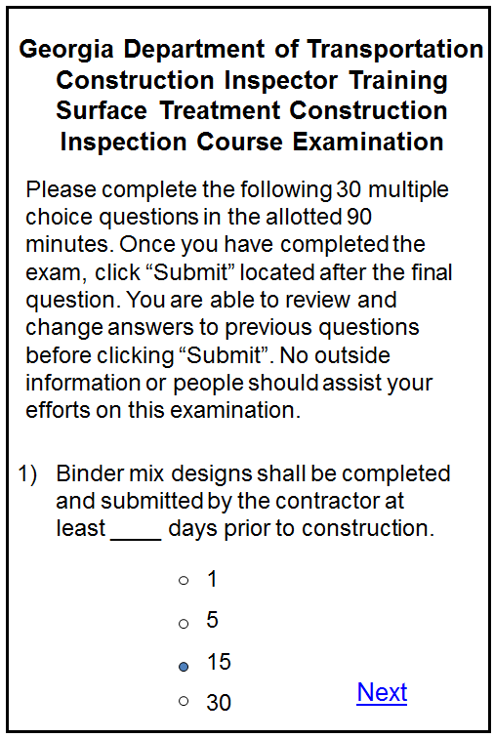
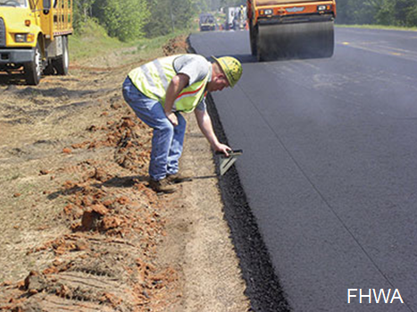
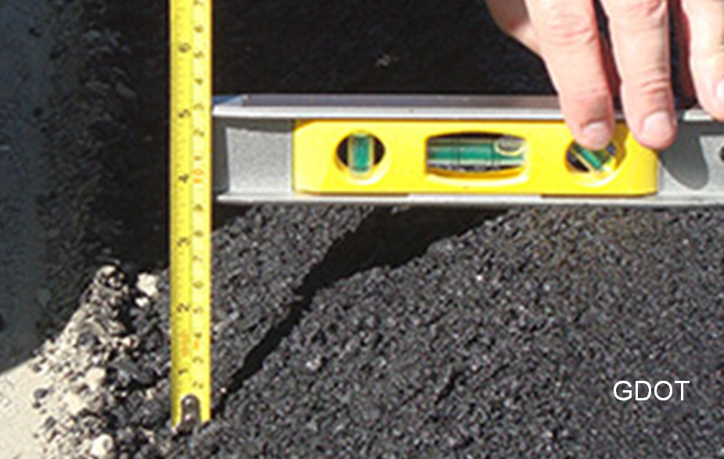
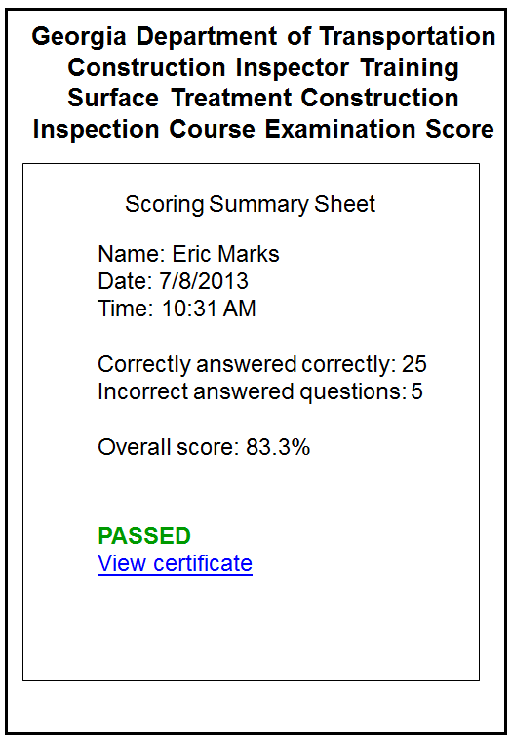
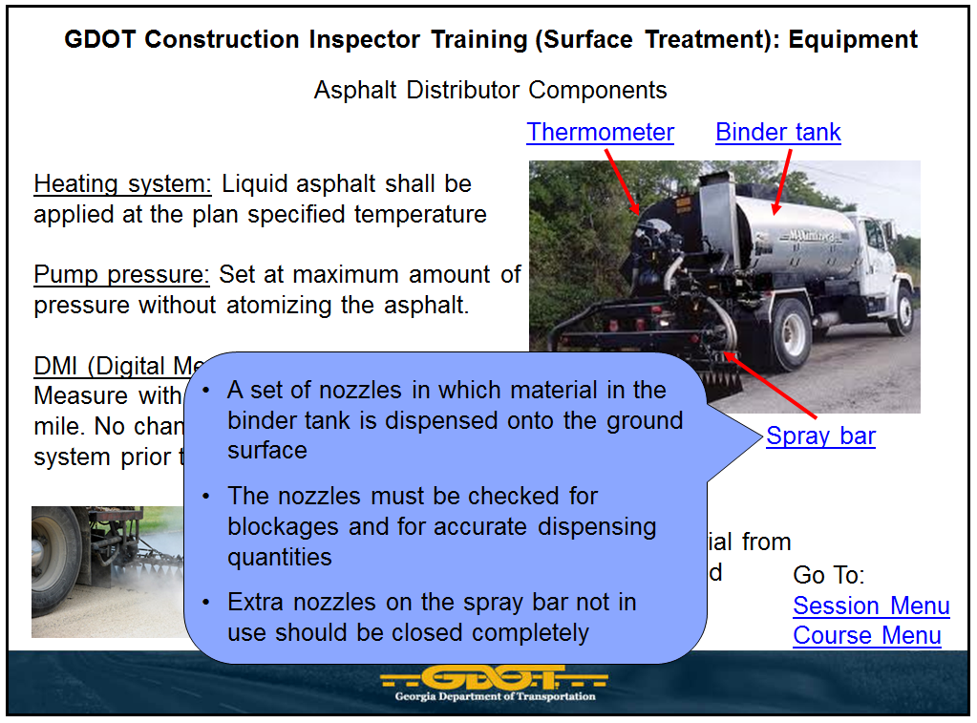
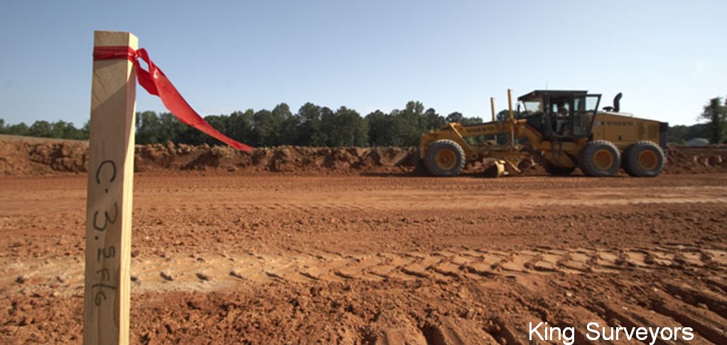
Training and Certification for Construction Inspectors
Erica Thompson and Eric Marks, P.E., and Dr. Jochen Teizer, Ph.D.
Rapids Construction Safety & Technology Laboratory
School of Civil and Environmental Engineering
Erica Thompson
ethompson10@gatech.edu
1. Introduction
4. Methodology
The purpose is for State Department of Transportations (DOTs) to provide innovative ways in implementing training and certification opportunities for construction inspectors.
Importance of Construction Inspectors:
Inspectors provide quality assurance of construction projects
Increase in transportation infrastructure projects
Major Problems:
Lack of consistent certification method
Limited number of experienced and knowledgeable construction inspectors
Goals:
Create best practices for construction inspection
Create training and certification modules for construction inspectors
Available Training Methods:
1) Live instructor (central office)
2) Live instructor (district office)
3) Webinar
4) Self-paced and web-based
Evaluation Metrics:
1) Cost
2) Time
3) Quality
4) Implementation Strategy
5) Ease of Updating Information
Research Flowchart
Benefits (per course):
Decrease travel time (85 hrs)
Cost savings ($2,466)
Personnel planning improved
time management
Limitations:
  Security logistics
  Frequency of certification
  Bypass courses for
  experienced inspectors
2. Background
Comparison Chart for Evaluation
Highway Transportation
Infrastructure is currently
underfunded (FHWA 2011)
Construction inspectors are required to perform 4 times the workload of inspectors in 1978 (FHWA 2011)
Construction inspectors are an important asset to any DOT because they provide quality assurance on transportation infrastructure construction projects
GDOT currently lacks a
system to transfer
knowledge from
experienced inspectors
to new employees
Quality training and
certification need to be available for
GDOT inspectors
5. Results
Primary Objectives
1) Provide recommendations for best
inspection practices for transportation
construction infrastructure projects
2) Create a delivery system for construction
inspector training/certification materials
3. Objective
6. Conclusion
Provided best inspection practices and training for GDOT construction inspectors
Investigated current inspection practices for highway, roadway, and bridge projects
Compared existing inspection practices and recommended new inspection procedures
Created self-paced collection of instructional modules and certification exams
Developed self-paced web-based training/certification system for construction inspectors

